Slide 1
Review of Chapters 1- 5
We review some important themes from the first 5 chapters
Introduction
Statistics- Set of methods for collecting/analyzing data (the art and science of learning from data). Provides methods for
Design – Planning / Implementing a study
Description – Graphical and numerical methods for summarizing the data
Inference – Methods for making predictions about a population (total set of subjects of interest, real or conceptual), based on a sample

Slide 2
2. Sampling and Measurement
Variable – a characteristic that can vary in value among subjects in a sample or a population.
Types of variables
Categorical
Quantitative
Categorical variables can be ordinal (ordered categories) or nominal (unordered categories)
Quantitative variables can be continuous or discrete
Classifications affect the analysis; e.g., for categorical variables we make inferences about proportions and for quantitative variables we make inferences about means

Slide 3
Randomization – obtaining reliable data by reducing potential bias
Simple random sample: In a sample survey, each possible sample of size n has the same chance of being selected.
Randomization in a survey used to get a good cross-section of population. With such probability sampling methods, standard errors tell us how close sample statistics tend to be to population parameters. (Otherwise, the sampling error is unpredictable.)
Notes:
See text for discussion of random number table to help select

Slide 4
Experimental vs. observational studies
Sample surveys are examples of observational studies (merely observe subjects without any experimental manipulation)
Experimental studies: Researcher assigns subjects to experimental conditions.
  Subjects should be assigned at random to the conditions (“treatments”)
  Randomization “balances” treatment groups with respect to lurking variables that could affect response (e.g., demographic characteristics, SES), makes it easier to assess cause and effect
Notes:
At least for large n

Slide 5
3. Descriptive Statistics
Numerical descriptions of center (mean and median), variability (standard deviation – typical distance from mean), position (quartiles, percentiles)
Bivariate description uses regression/correlation (quantitative variable), contingency table analysis (categorical variables). Graphics include histogram, box plot, scatterplot

Slide 6
Mean drawn toward longer tail for skewed distributions, relative to median.
Properties of the standard deviation s:
  s increases with the amount of variation around the mean
  s depends on units of the data (e.g. measure euro vs $)
  Like mean, affected by outliers
  Empirical rule: If distribution approx. bell-shaped,
  about 68% of data within 1 std. dev. of mean
  about 95% of data within 2 std. dev. of mean
  all or nearly all data within 3 std. dev. of mean

Slide 7
Sample statistics /
Population parameters
We distinguish between summaries of samples (statistics) and summaries of populations (parameters).
Denote statistics by Roman letters, parameters by Greek letters:
Population mean =μ, standard deviation = σ, proportion  are parameters. In practice, parameter values are unknown, we make inferences about their values using sample statistics.

Slide 8
4. Probability Distributions
Probability: With random sampling or a randomized experiment, the probability an observation takes a particular value is the proportion of times that outcome would occur in a long sequence of observations.
A probability distribution lists all the possible values and their probabilities (which add to 1.0)

Slide 9
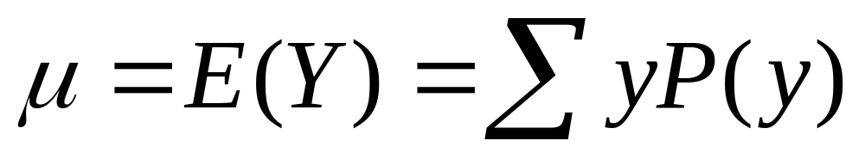
Like frequency dist’s, probability distributions have mean and standard deviation
Standard Deviation - Measures the “typical” distance of an outcome from the mean, denoted by σ

Slide 10
Normal distribution
Symmetric, bell-shaped
Characterized by mean (μ) and standard deviation (σ), representing center and spread
Prob. within any particular number z of standard deviations of μ is same for all normal distributions
An individual observation from an approximately normal distribution satisfies:
  Probability 0.68 within 1 standard deviation of mean
  0.95 within 2 standard deviations
  0.997 (virtually all) within 3 standard deviations

Slide 11
Notes about z-scores
z-score represents number of standard deviations that a value falls from mean of dist.
A value y is z = (y - µ)/σ standard deviations from µ
The standard normal distribution is the normal dist with µ = 0, σ = 1

Slide 12
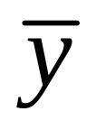
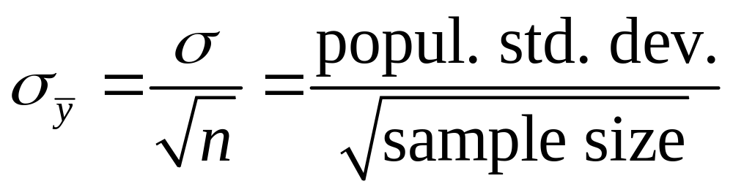
Sampling dist. of sample mean
is a variable, its value varying from sample to sample about population mean µ. Sampling distribution of a statistic is the probability distribution for the possible values of the statistic
Standard deviation of sampling dist of is called the standard error of
For random sampling, the sampling dist. of
has mean µ and standard error

Slide 13
Central Limit Theorem: For random sampling with “large” n, sampling dist of sample mean is approximately a normal distribution
Approx. normality applies no matter what the shape of the population distribution
How “large” n needs to be depends on skew of population dist, but usually n ≥ 30 sufficient
Can be verified empirically, by simulating with “sampling distribution” applet at www.prenhall.com/agresti. Following figure shows how sampling distribution depends on n and shape of population distribution.

Slide 14
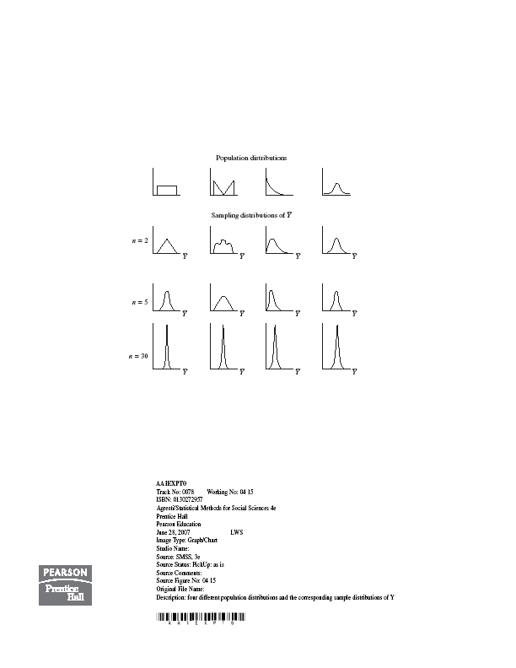

Slide 15
5. Statistical Inference: Estimation
Point estimate: A single statistic value that is the “best guess” for the parameter value (such as sample mean as point estimate of popul. mean)
Interval estimate: An interval of numbers around the point estimate, that has a fixed “confidence level” of containing the parameter value. Called a confidence interval.
(Based on sampling dist. of the point estimate, has form point estimate plus and minus a margin of error that is a z or t score times the standard error)

Slide 16

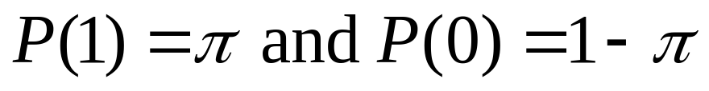
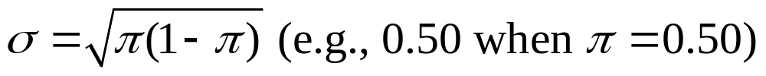
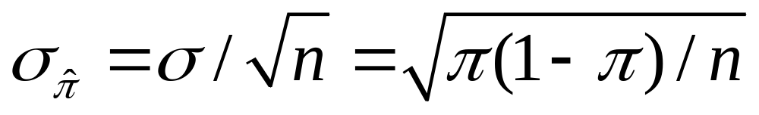
Confidence Interval for a Proportion
(in a particular category)
Sample proportion is a mean when we let y=1 for observation in category of interest, y=0 otherwise
Population prop. is mean µ of prob. dist having
The standard deviation of this prob. dist. is
The standard error of the sample proportion is

Slide 17
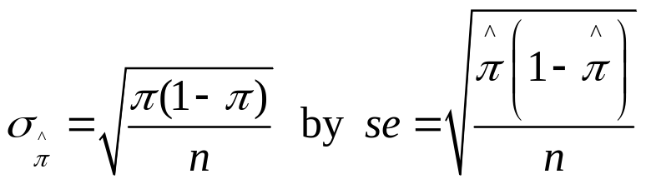

Finding a CI in practice
Complication: The true standard error
itself depends on the unknown parameter!
In practice, we estimate
and then find 95% CI using formula

Slide 18
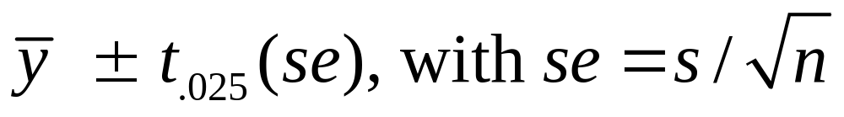
CI for a population mean
For a random sample from a normal population distribution, a 95% CI for µ is
where df = n-1 for the t-score
Normal population assumption ensures sampling dist. has bell shape for any n (Recall figure on p. 93 of text and next page). Method is robust to violation of normal assumption, more so for large n because of CLT.

Slide 19
Questions you should be able to answer:
What is the difference between descriptive statistics and inferential statistics? Give an example of each.
Why do we distinguish between quantitative variables and categorical (nominal and ordinal) variables?
What is a simple random sample?
Why should a survey use random sampling, and why should an experiment use randomization in assigning subjects to treatments?
What is the difference between an experiment and an observational study?
Define the mean and median, and give an advantage and disadvantage of each. Give an example when they would be quite different? Which would be larger, and why?
How do you interpret a standard deviation?

Slide 20
Which measures are resistant to outliers: Mean, median, range, standard deviation, inter-quartile range?
What information does a box plot give you?
How can you describe an association between two
(i) quantitative variables, (ii) categorical variables
What is the correlation used for, and how do you interpret its value?
If you know or can estimate P(A) and P(B), how do you find P(A and B) when A and B are independent?
How do you use the normal distribution to get tail probabilities, central probabilities, z-scores?
What does the z-score represent?
What is a sampling distribution?
What is a standard error?
What’s the difference between s, σ, se. Which is the smallest?
Why is the normal distribution important in statistics?

Slide 21
What does the Central Limit Theorem say? Why is it important in statistical inference?
What are the differences among (i) population distribution, (ii) sample data distribution, (iii) sampling distribution?
How do you interpret a confidence interval?
Why do standard errors have to be estimated, and what impact does that have (i) for inference about a proportion, (ii) for inference about a mean?
How does the t distribution depend on the df value, and how does it compare to the standard normal distribution?
How does a confidence interval depend on the (i) sample size, (ii) confidence level? How do you find the z-score or t-score for a particular confidence?
Why do you use a t-score instead of a z-score when you find the margin of error for a confidence interval for a mean?

